Slide 1
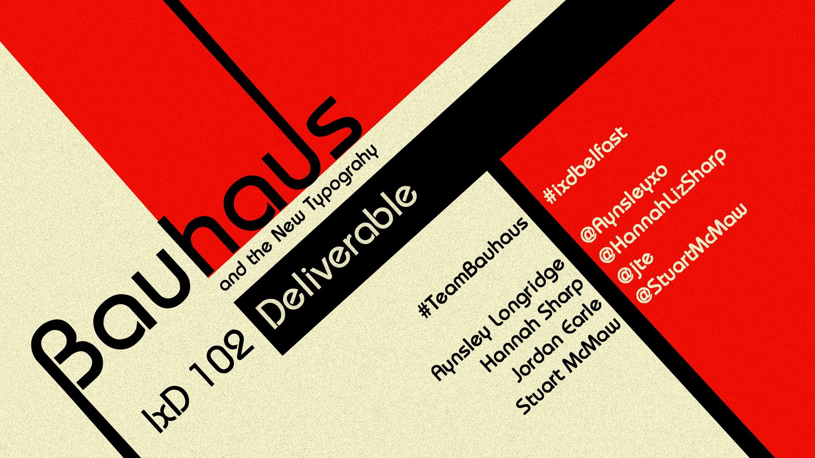
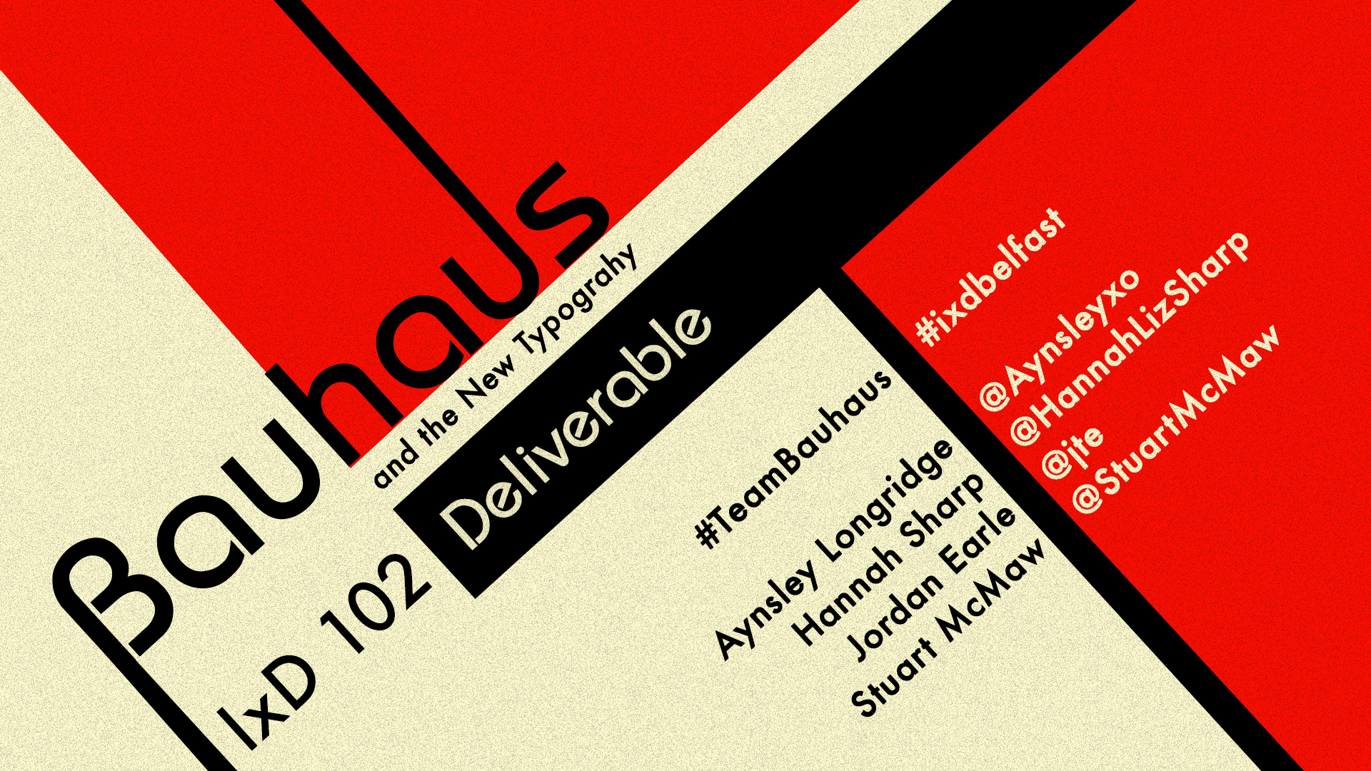

Slide 2


Topics we will be covering:
Introduction to Bauhaus
Introduction to the new Typography Movement
Type and Design
Artwork and Artists
Bauhaus in Popular Culture

Slide 3

Introduction to Bauhaus

Slide 4

Introduction to the New Typography Movement

Slide 5

Type and Graphic Design

Slide 6
Artworks and Artists

Slide 7

Bauhaus in Popular Culture

Slide 8

Thank you for listening
#TeamBauhaus
Any Questions?
#ixdbelfast

